Slide 1
Mid defense Final Year Project
Supervisor: Mr. A.P Zakriya Jamali
Co-Supervisor: Samar Raza Talpur

Slide 2
AGENDA
Introduction​
Software Requirement Specification
​Software Design Specification
Literature Review

Slide 3
Early Brain tumor detection Web-based application
Introduction
The project focuses on using Al and advanced imaging to detect brain tumors from MRI or CT scans.
The goal is to enhance early detection, aid in treatment planning, and improve patient outcomes through accurate and efficient tumor detection

Slide 4
Software Requirement Specification
Purpose of the Document
Intended Audience
Project Scope
Not in Scope
Functional Requirements
Non-Functional

Slide 5
Purpose of the Document
The purpose of this document for the Final Year Project (FYP) is to provide a Software Requirements Specification (SRS) for a web-based Early Brain Tumor detection. The SRS document outlines the system's scope and defines its boundaries, ensuring that all users have a clear understanding of the project's objectives.

Slide 6
Intended Audience
The intended audience for this Software Requirements Specification (SRS) document is anyone involved in the development, testing, deployment, and maintenance of the web-based Early Brain Tumor Detection.

Slide 7
Project Scope
The Application facilitates continuous monitoring of tumor growth and changes over time, thereby assisting medical professionals in making informed decisions.
UI, Testing, System Architecture, Deliverables

Slide 8
Not in scope
Integration with any external systems or services not explicitly mentioned in this document.
While early detection is crucial, the actual treatment planning and execution may be beyond the scope of a detection project. This involves decisions about surgery, chemotherapy, radiation therapy, etc.
Implementation of any payment or transaction processing functionality.
Implementation of any social media or external sharing functionality.
Implementation of any data analytics or reporting functionality.

Slide 9
Functional Requirements
User Registration
Login
Upload Image
Detect Brain Tumor

Slide 10
Non-Functional
User-friendly and easy to navigate
The system shall be designed to protect user data and prevent unauthorized access.
The system shall also have a response time of less than 5 seconds for all user requests.

Slide 11
Software Design Specification
Introduction
Use Case Diagram
Sequence Diagram
Activity Diagram

Slide 12
Introduction
The purpose of this document is to describe my final year project named ”Early Brain Tumor Detection” in detail and a high-level design framework around which to build the final year project named Early Brain Tumor Detection.

Slide 13
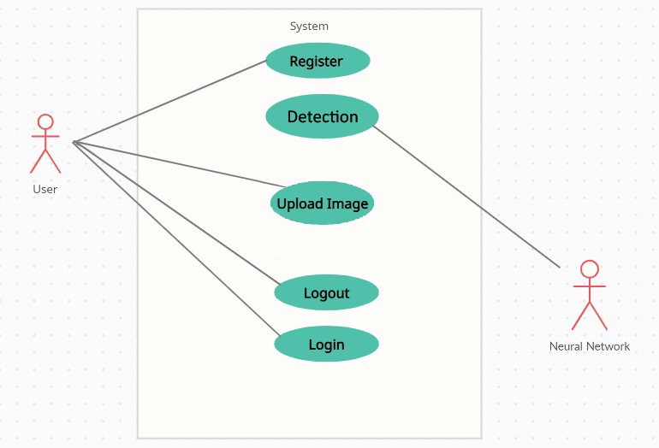
Use Case Diagram

Slide 14
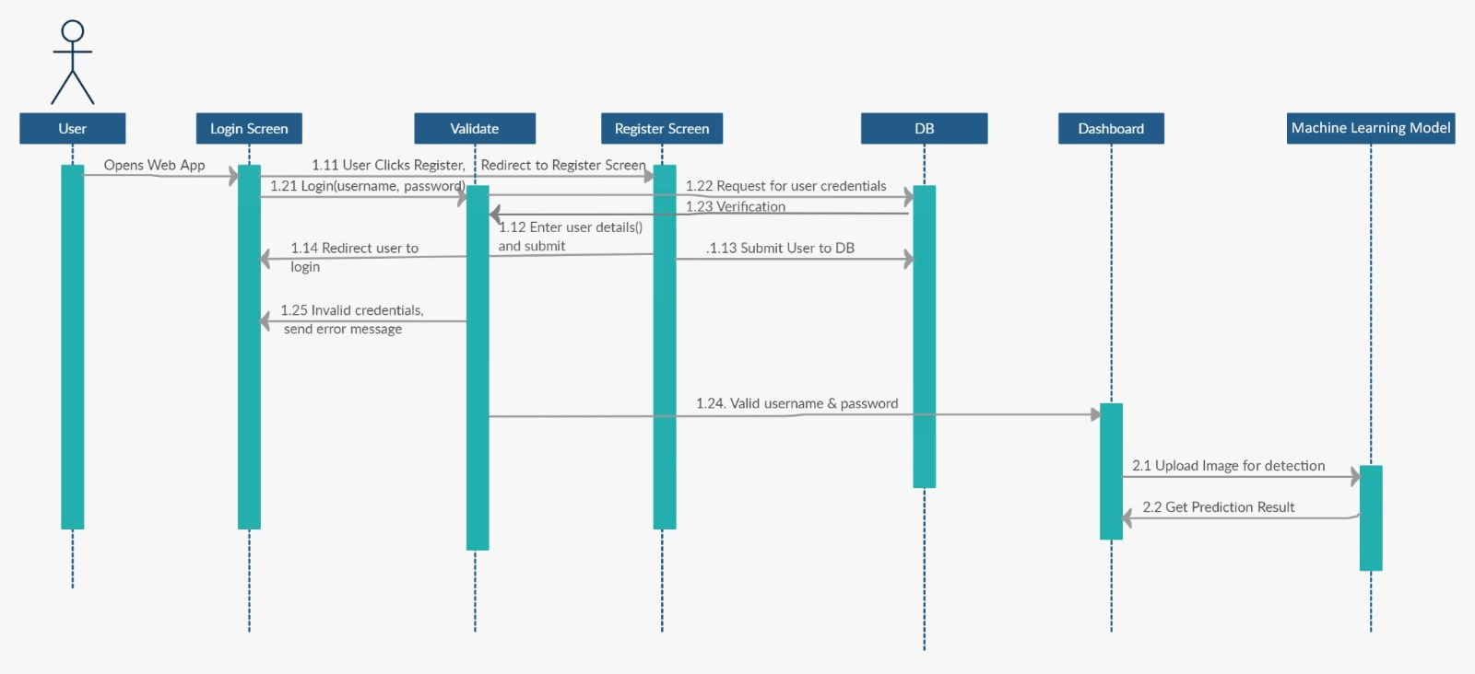
Sequence Diagram

Slide 15
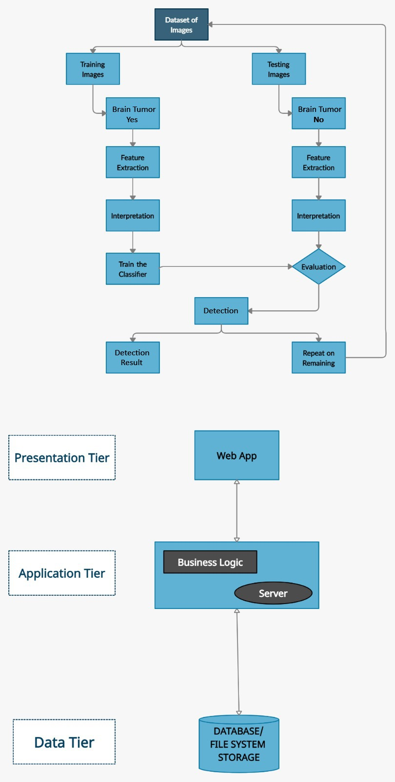
Activity Diagram

Slide 16
Literature Review
Word File Available

Slide 17
THANK YOU

